Slide 1
eSignature
Maybank M2U Apps

Slide 2


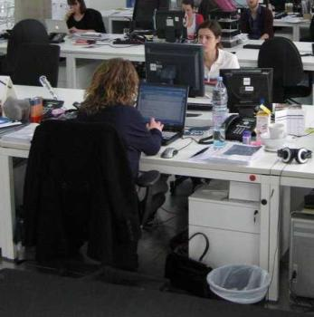
The Idea
Relationship
Manager
Customer
Back Office
Hardcopy
Wet Signature
Execute based on Hardcopy
Scanned Hardcopy
Digital Signature
(M2U)
Execute based on Softcopy

Slide 3
Infrastructure
Relationship
Manager
Customer
Back Office
Device | SmartPhone / Laptop | SmartPhone | Desktop / Laptop
Tools | Mobile Responsive Web | M2U ID App | Desktop Web
User ID | Active Directory | M2U User ID | Active Directory

Slide 4
Form Table
1
2
Product | Activity
Investment | Subscription
Investment | Redemption
Investment | Switching
Bonds | Buy
Bonds | Sell
Banca | Subscription

Slide 5
Relationship Manager User Interface

Slide 6
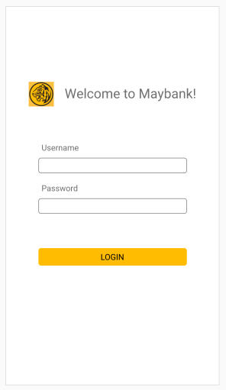
Login
Login: UserID and Password
UserID is Active Directory UserID
There will be WhiteList table to list which UserIDs are allowed to Login
AutoLogout Timeout = 10min without Activity
MockUp:
https://xd.adobe.com/view/2d2983d9-3903-4f11-71cd-cf4d8ae0be0f-5b18/

Slide 7
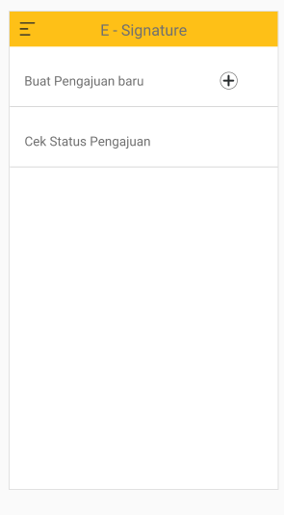
Proposal Creation
There will be two options:
  Create New Proposal
  Check Status

Slide 8
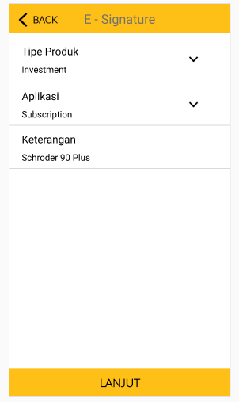
Proposal Creation
Product Type:
  Drop Down Menu
  Pre-Defined from Field Product (1) at Slide4 (Form Table)
Aplication:
  Drop Down Menu
  Pre-Defined from Field Activity (2) at Slide 4
Remarks:
  Free Text
  Alphanumeric max 50Char
  RM to manually Key-In Product Name

Slide 9
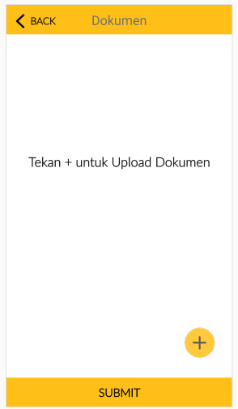
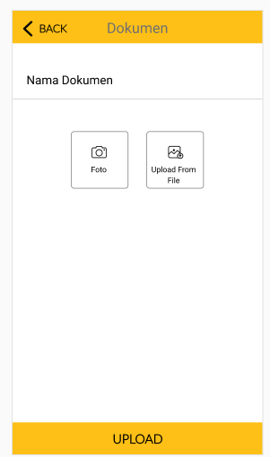
Proposal Creation
Document Name
  Free Text
  Alphanumeric (25 Char)
Document Upload:
  Photo
  File Upload

Slide 10
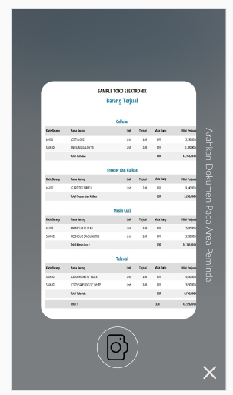
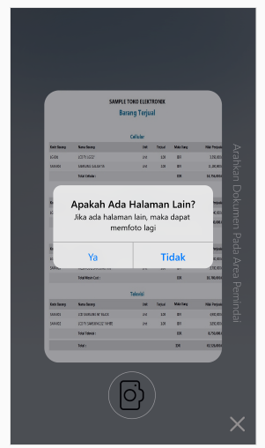
Proposal Creation
Sample Case 1: Subscription form with 1 page only
  RM press Photo
  Then RM press “Tidak”
  Photo will be converted to PDF
Sample Case 2: TnC document with 2 pages
  RM Press Photo at Page1
  Then RM Press “Ya”
  RM Press Photo at Page2
  Then RM Press “Tidak”
  Two Photos will be converted to 2 Pages 1 File PDF

Slide 11
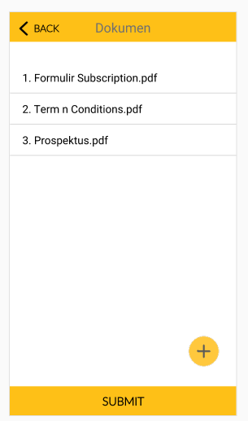
Proposal Creation
Plus button (+) : to add Document required for certain activity. i.e for Investment Subscription need to upload Subscription form, TnC, Prospectus, Risk Profile, etc
In Each File Name there will be button to delete file.

Slide 12
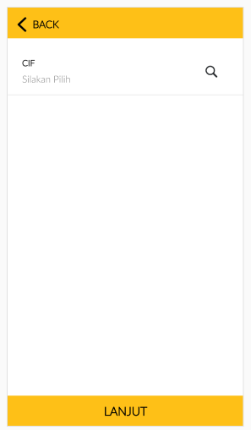
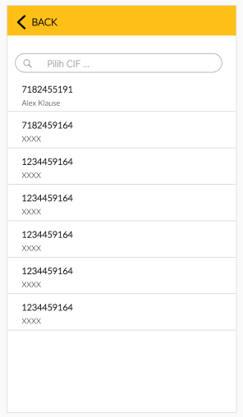
Proposal Creation
RM Search Customer by entering CIF number

Slide 13
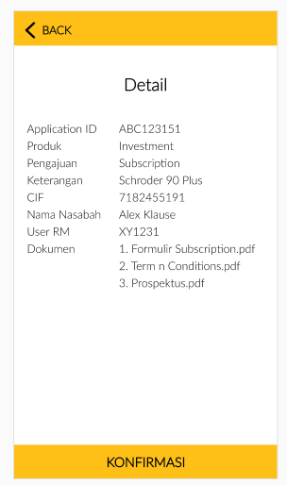
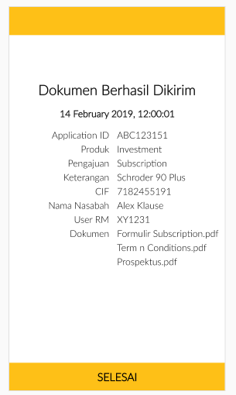
RM Tools
There will be Confirmation Page before push document to Customer M2U
There will be Successful Notification screen.
Possible Error:
  Customer does not have M2U

Slide 14
Customer Approval: M2U

Slide 15
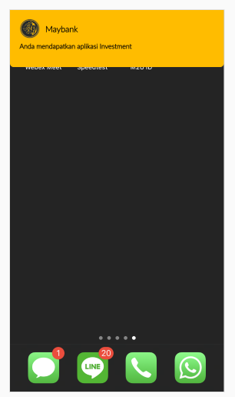
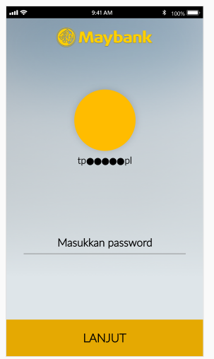
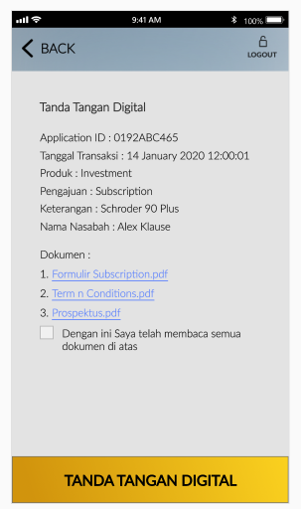
Customer Approval: M2U
Sample Case1: Customer get Push Notification for eSignature . Customer clicks the notification then password page will be prompted. Customer is now on eSignature confirmation page
Mock Up: https://xd.adobe.com/view/1dc82153-ff58-4349-5ddf-40829618ba81-6bf9/

Slide 16
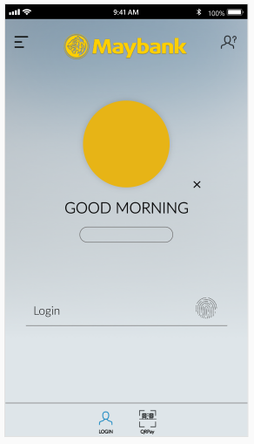
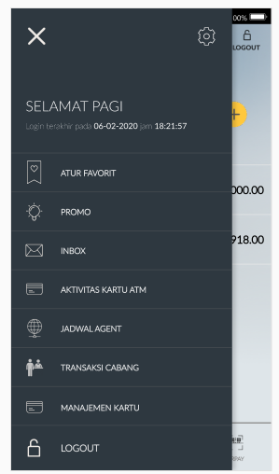
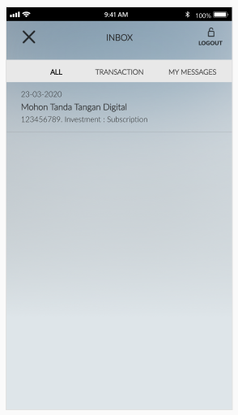
Customer Approval: M2U
Sample Case2: Customer manually login to M2U (password / biometric). Customer go to burger menu and choose Inbox. Customer clicks on the eSignature Message. Customer is now on eSignature confirmation page
Mock Up: https://xd.adobe.com/view/ad26f47c-d9ac-4290-65ac-bf5f5d2cf24f-db17/

Slide 17
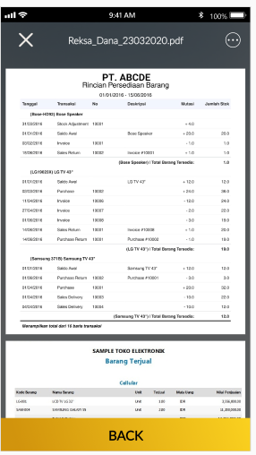
Customer Approval: M2U
Customer may Click on each file and can read each document
Customer must tick on the consent statement before submitting the eSignature

Slide 18
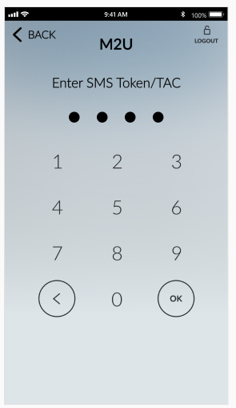
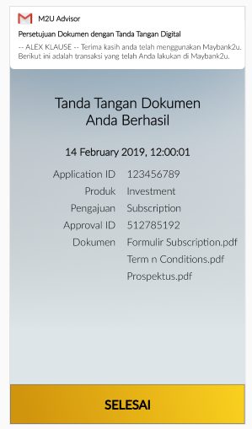
Customer Approval: M2U
To fulfill 2FA requirement, Customer need to enter SMS TAC
Customer will get successful email notification
ApprovalID is unique per ApplicationID and have certain formula to calculate.

Slide 19
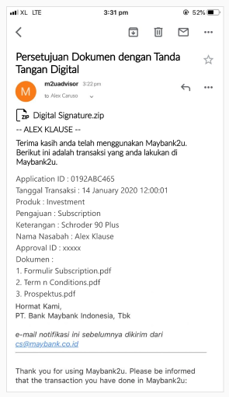
Customer Approval: M2U
Successful email notification will be sent to Customer.
There will be attachment consist of 1 zip file.
Zip filename: [Product][Activity][ApplicationID].zip i.e: InvestmentSubscription123456789.zip
Zip file will consist:
  All attachment files.
  Certificate Approval file (pdf, printable)

Slide 20
BackOffice User Interface

Slide 21
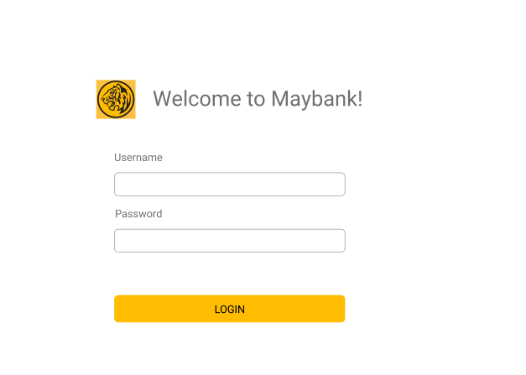
BackOffice User Interface
Login: UserID and Password
UserID is Active Directory UserID
There will be WhiteList table to list which UserIDs are allowed to Login
AutoLogout Timeout = 10min without Activity
MockUp:
https://xd.adobe.com/view/ba275413-24c9-4283-7d7a-5d59c4aeb765-cc16/

Slide 22
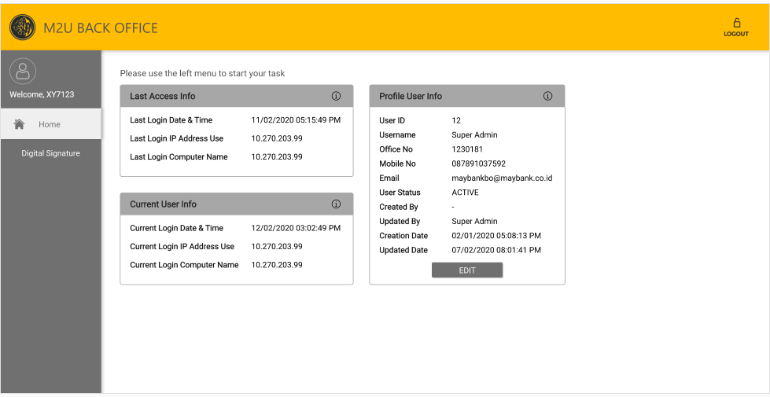
BackOffice User Interface
First Dashboard is User Dashboard (field will be defined later based on priority)
There will be specific menu for Digital Signature

Slide 23
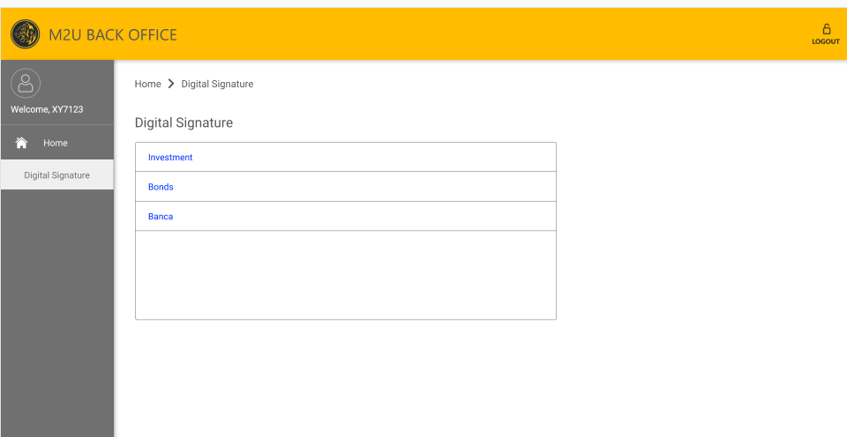
BackOffice User Interface
Digital Signature Menu will be defined into category as per “Form Table” slide 4.
BackOffice UserID must be granted permission to access each menu.
BackOffice UserID must be granted permission to see only specific RM UserID.

Slide 24
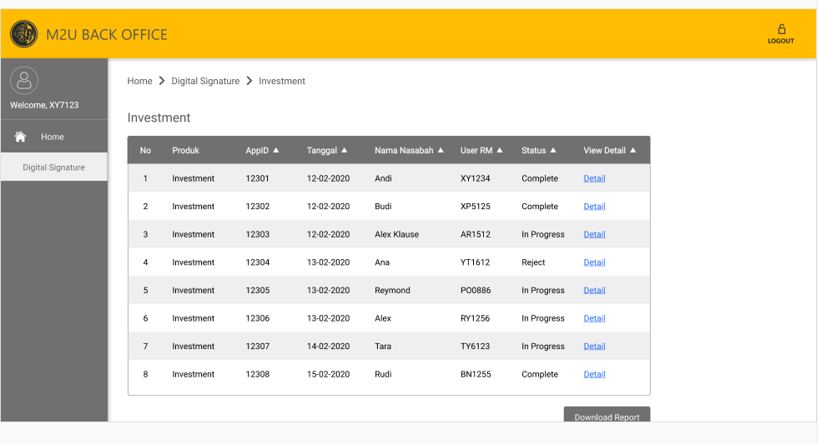
BackOffice User Interface
BackOffice User can generate report by excel. Excel is generated based on result on the screen.
BackOffice user can click “Detail” to change status.

Slide 25
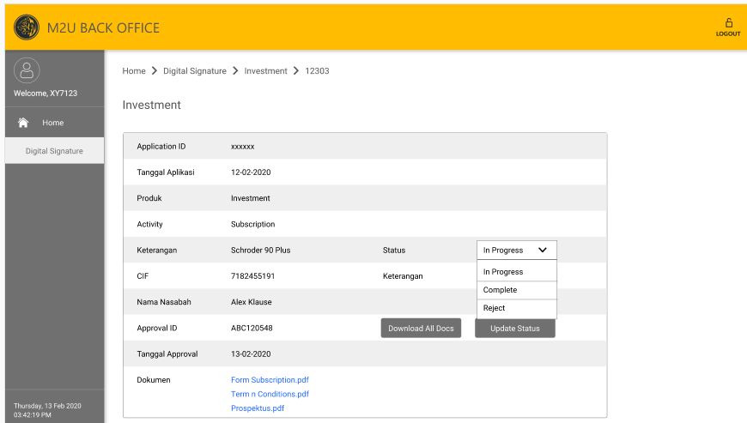
BackOffice User Interface
BackOffice User can review each document by clicking “document name”.
BackOffice user can change status “In Progress, Complete, Reject” and give Remarks.

